Slide 1
Lucky People
input:
person
person
sex
first name
last name
day of birth
month of birth
output:
lucky?
sex | enumeration | Male | Female
firstName | string | [A-Z][a-z]*
lastName | string | [A-Z][a-z]*
dayOfBirth | integer | 1 <= dayOfBirth <= 31
monthOfBirth | integer | 1 <= monthOfBirth <= 12
Notes:
Person: cartesian product of
Sex : enumaration of Male and Female
Names: strings
Day and month of birth: integers
Data constraints:
Regular expression on names

Slide 2

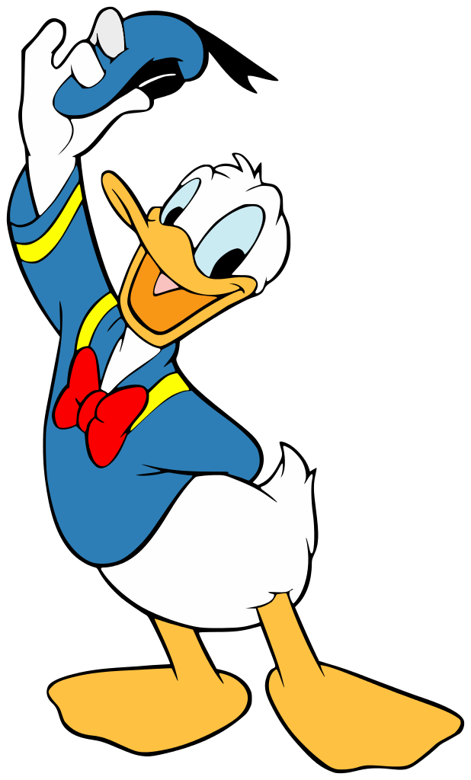
Lucky People
A person is lucky when either
  the first character of the first name is equal to
  the first character of the last name,

Slide 3
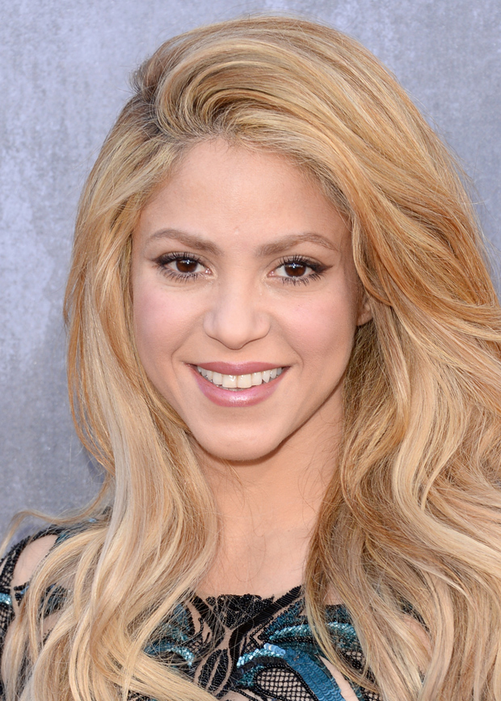

Lucky People
A person is lucky when either
  the first character of the first name is equal to
  the first character of the last name,
  the day of birth is equal to the month of birth, or
2 - 2 - 1977
9 - 9 - 1975
Notes:
Shakira - https://nl.wikipedia.org/wiki/Shakira
Michel Bublé - https://nl.wikipedia.org/wiki/Michael_Bubl%C3%A9

Slide 4
Lucky People
A person is lucky when either
  the first character of the first name is equal to
  the first character of the last name,
  the day of birth is equal to the month of birth, or
  the person is a Female after five Males or a Male after five Females.
M
M
M
M
M
F
F
F
F
F
M
F
F
M
Notes:
ONLY input
ONLY seks of person indicated:
M – Male
F – Female

Slide 5
Lucky People – Parameterize States
M
M
M
M
M
F
F
F
F
F
M
0
1
2
3
4
5
F
F
M
F
n := 1
M
n := n+1
F
n := n+1
n
n
M
n := 1

Slide 6
Lucky People – Exploit Symmetry
F
n := 1
M
n := n+1
F
n := n+1
(M,n)
(F,n)
M
n := 1
n := 0
S
IF (Last == S)
THEN n := n+1
ELSE n := 1; Last := S
(Last,n)
Notes:
Last

Slide 7
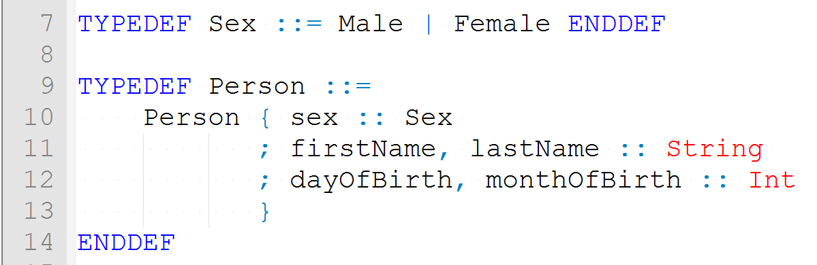
Lucky People – TorXakis model
person
sex
first name
last name
day of birth
month of birth
sex | enumeration | Male | Female
firstName | string | [A-Z][a-z]*
lastName | string | [A-Z][a-z]*
dayOfBirth | integer | 1 <= dayOfBirth <= 31
monthOfBirth | integer | 1 <= monthOfBirth <= 12

Slide 8
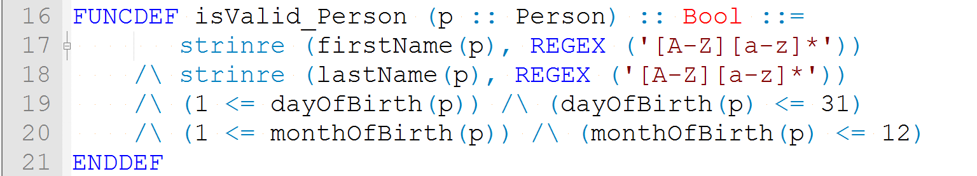
Lucky People – TorXakis model
sex | enumeration | Male | Female
firstName | string | [A-Z][a-z]*
lastName | string | [A-Z][a-z]*
dayOfBirth | integer | 1 <= dayOfBirth <= 31
monthOfBirth | integer | 1 <= monthOfBirth <= 12

Slide 9
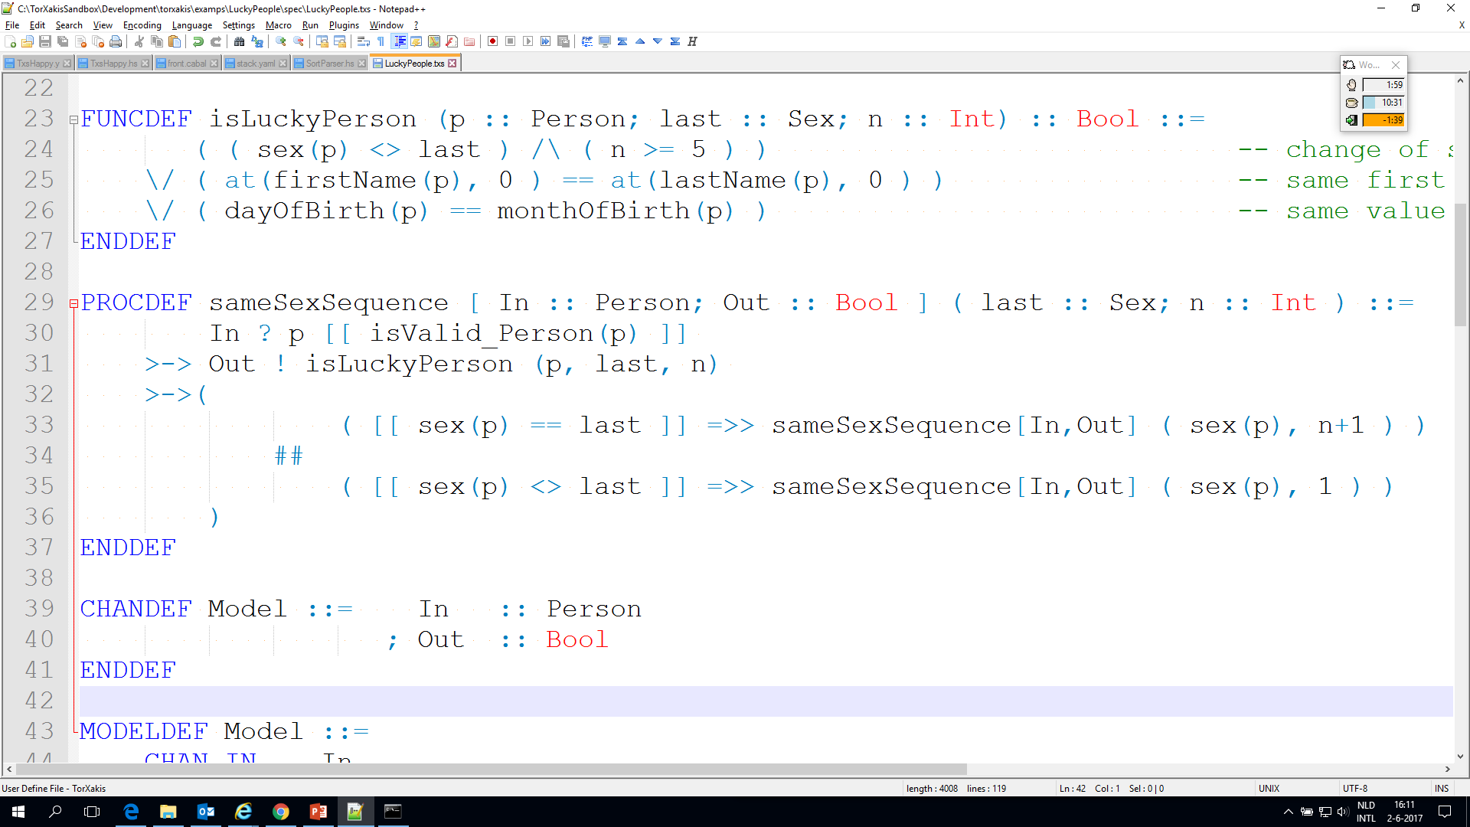
Lucky People – TorXakis model
n := 0
S
IF (Last == S)
THEN n := n+1
ELSE n := 1; Last := S
(Last,n)
Notes:
Recursive call ->
requires procdef with name to refer to: sameSexSequence

Slide 10
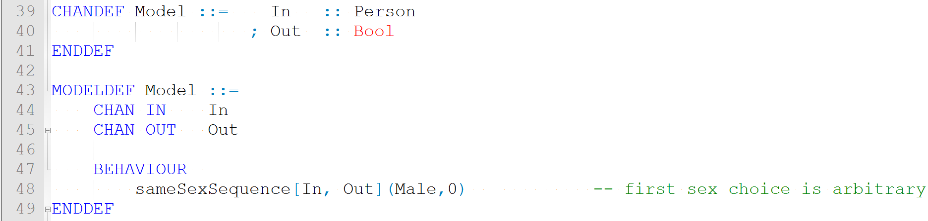
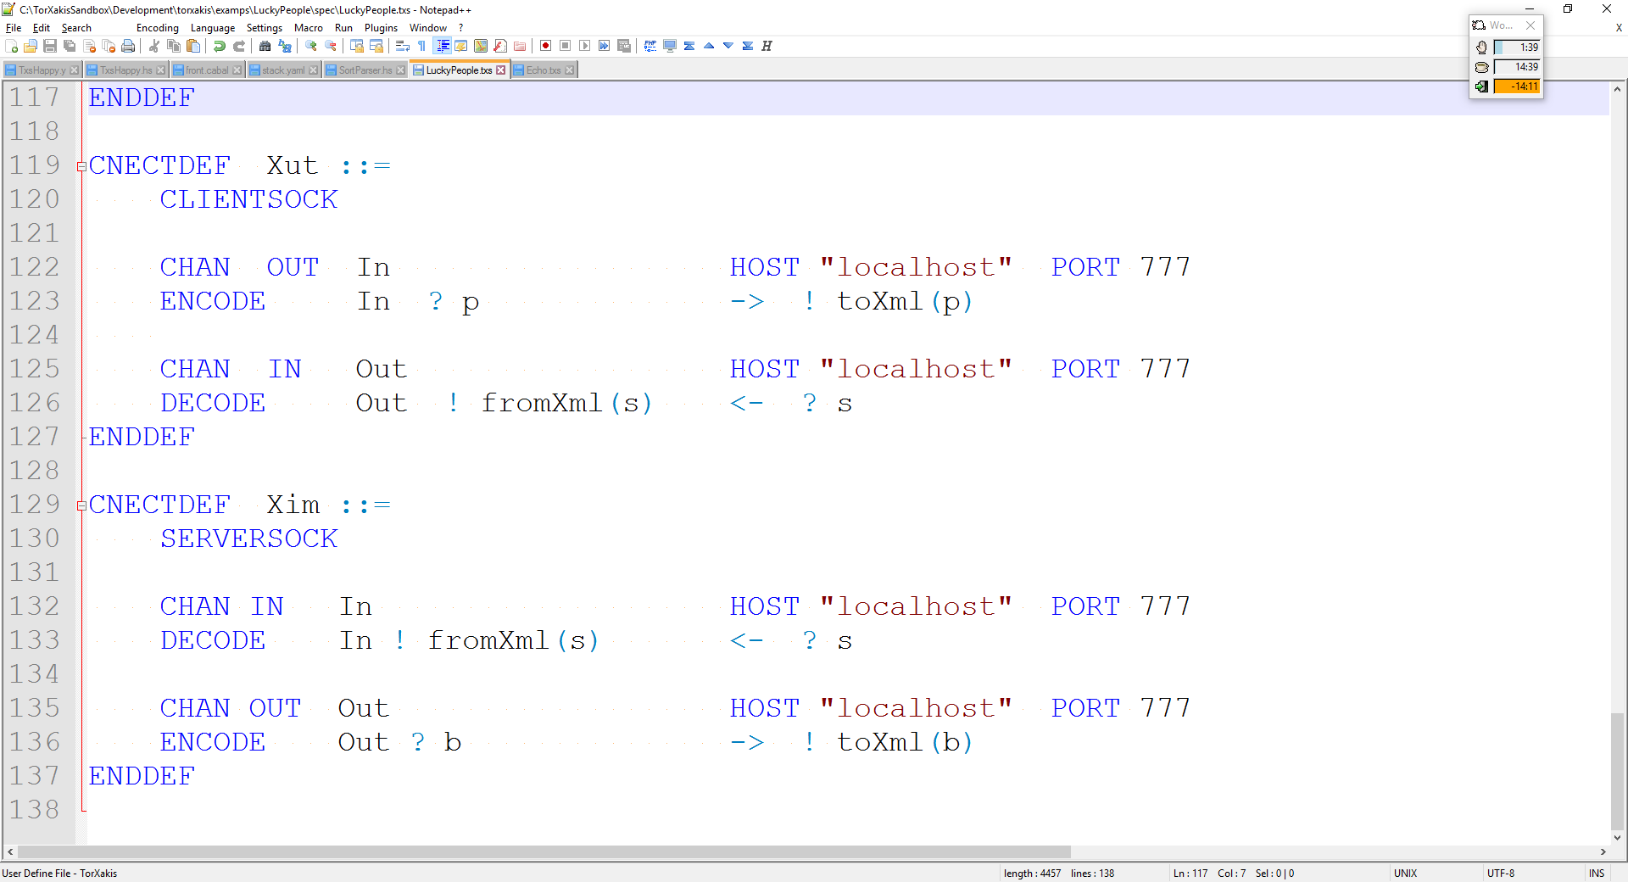
Lucky People – TorXakis model

Slide 11
Simulator
Test Driven Development
SUT not yet available
TorXakis can act as simulator

Slide 12
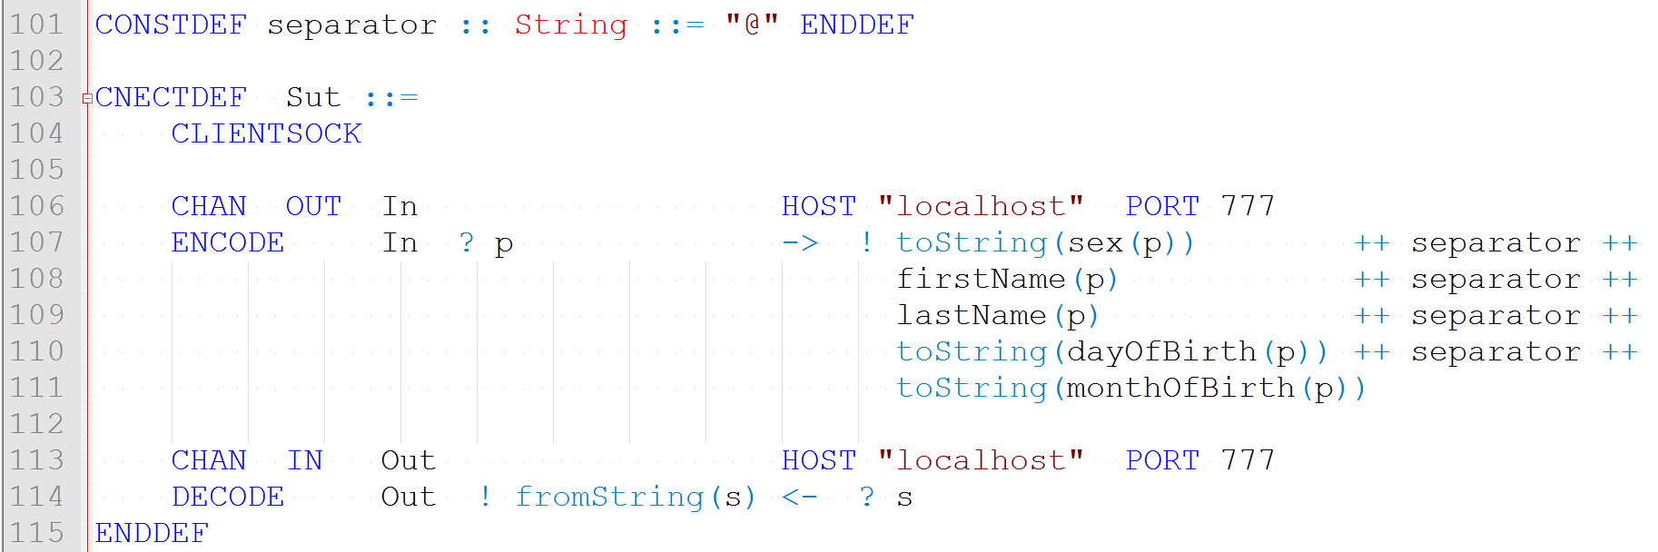
System Under Test
SUT available
Specific encoding

